Slide 1
Digital Circuit Experiment Combinational logical circuit
Lecture 2
Rencan Nie（聂仁灿）

Slide 2
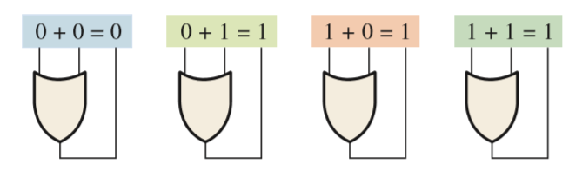

Theoretical Basis
Boolean Operations and Expressions
Boolean Addition
Boolean addition is equivalent to the OR operation. In Boolean algebra, a sum term is a sum of literals. In logic circuits, a sum term is produced by an OR operation.
A sum term is equal to 1 when one or more of the literals in the term are 1. A sum term is equal to 0 only if each of the literals is 0.

Slide 3
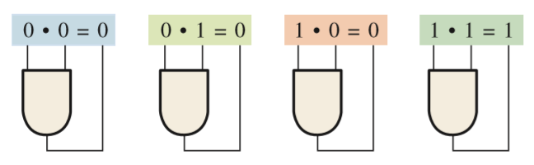

Theoretical Basis
Boolean Operations and Expressions
Boolean Multiplication
Boolean multiplication is equivalent to the AND operation. In Boolean algebra, a product term is the product of literals. In logic circuits, a product term is produced by an AND operation.
A product term is equal to 1 only if each of the literals in the term is 1. A product term is equal to 0 when one or more of the literals are 0.

Slide 4


Theoretical Basis
Laws and Rules of Boolean Algebra
Laws of Boolean Algebra
Commutative Laws : The commutative law of addition for two variables is written as.
This law states that the order in which the variables are ORed makes no difference.
Commutative Laws : The commutative law of multiplication for two variables is written as.
This law states that the order in which the variables are ANDed makes no difference.

Slide 5

Theoretical Basis
Laws and Rules of Boolean Algebra
Laws of Boolean Algebra
Associative Laws: The associative law of addition is written as follows for three variables:
This law states that when ORing more than two variables, the result is the same regardless of the grouping of the variables.
Associative Laws: The associative law of multiplication is written as follows for three variables:
This law states that it makes no difference in what order the variables are grouped when ANDing more than two variables.

Slide 6

Theoretical Basis
Laws and Rules of Boolean Algebra
Laws of Boolean Algebra
Distributive Law : The distributive law is written for three variables as follows:
This law states that ORing two or more variables and then ANDing the result with a single variable is equivalent to ANDing the single variable with each of the two or more variables and then ORing the products. The distributive law also expresses the process of factoring in which the common variable A is factored out of the product terms, for example, AB + AC = A(B + C).

Slide 7
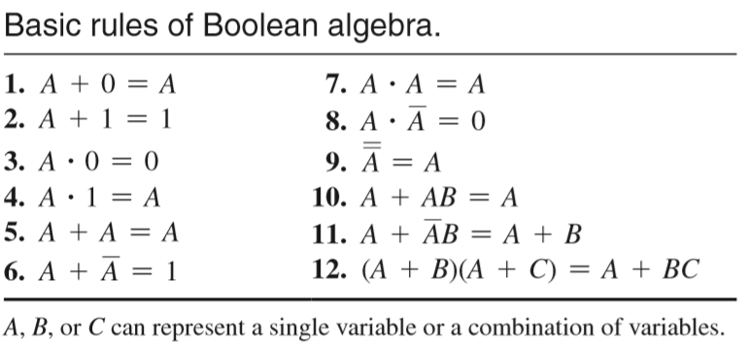
Theoretical Basis
Laws and Rules of Boolean Algebra
Rules of Boolean Algebra

Slide 8


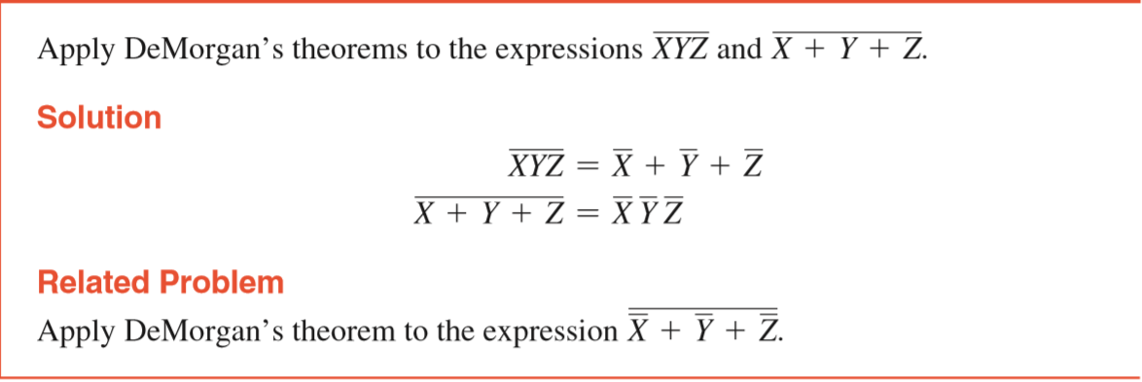
Theoretical Basis
Laws and Rules of Boolean Algebra
DeMorgan’s Theorems
The complement of two or more ANDed variables is equivalent to the OR of the complements of the individual variables.
The complement of two or more ORed variables is equivalent to the AND of the complements of the individual variables.

Slide 9
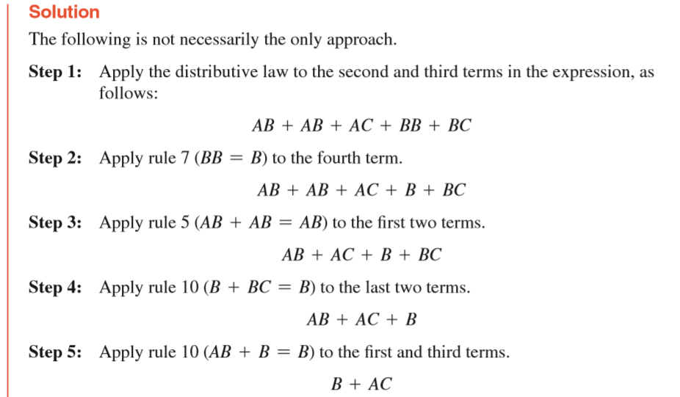
Theoretical Basis
Logic Simplification Using Boolean Algebra
Apply the laws, rules, and theorems of Boolean algebra to simplify general expressions.
Example 1. AB + A(B + C) + B(B + C)

Slide 10
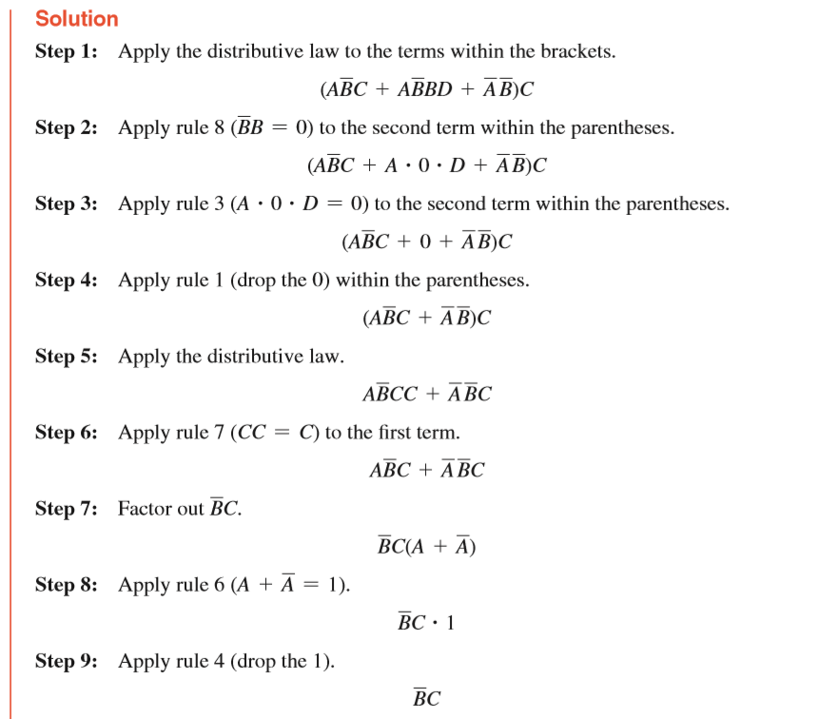
Theoretical Basis
Logic Simplification Using Boolean Algebra
Example 2. [AB(C + BD) + A B]C

Slide 11
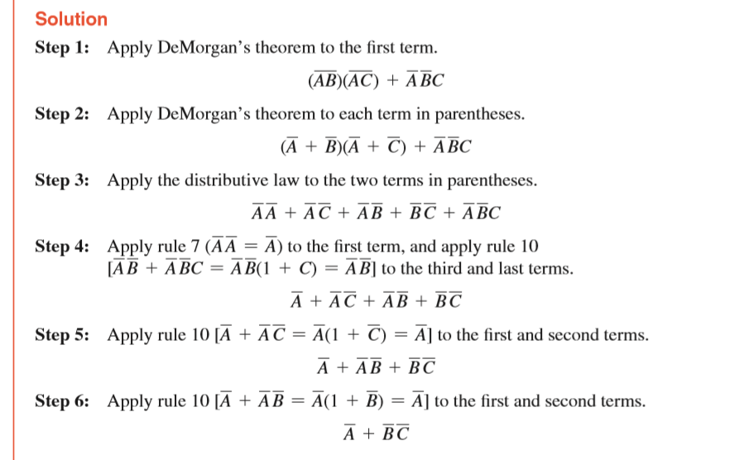
Theoretical Basis
Logic Simplification Using Boolean Algebra
Example 3. AB + AC + A BC

Slide 12
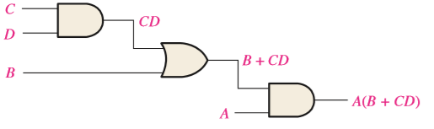
Theoretical Basis
Boolean Expression for a Logic Circuit
To derive the Boolean expression for a given combinational logic circuit, begin at the left-most inputs and work toward the final output, writing the expression for each gate.
The expression for the left-most AND gate with inputs C and D is CD.
The output of the left-most AND gate is one of the inputs to the OR gate and B is the other input. Therefore, the expression for the OR gate is B + CD.
The output of the OR gate is one of the inputs to the right-most AND gate and A is the other input. Therefore, the expression for this AND gate is A(B + CD), which is the ﬁnal output expression for the entire circuit.
A(B + CD)

Slide 13
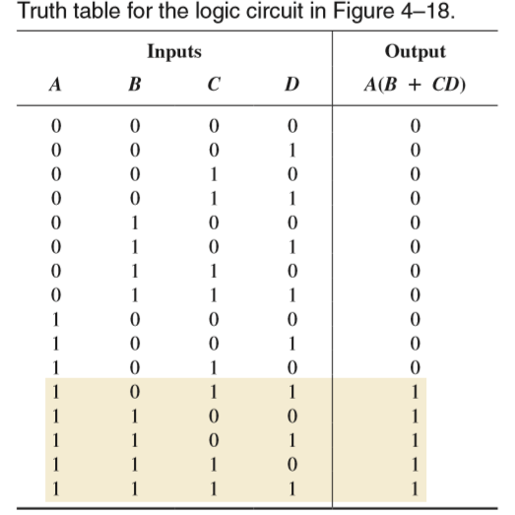
Theoretical Basis
Boolean Expression for a Logic Circuit
Putting the Results in Truth Table Format:
A(B + CD)

Slide 14
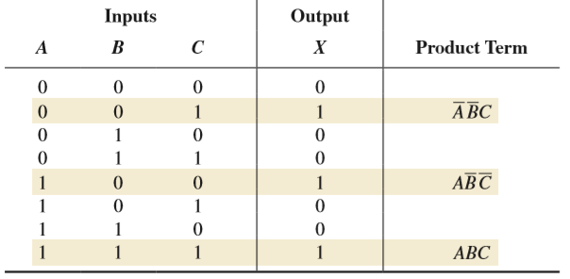
Theoretical Basis
Converting SOP Expressions to Truth Table Format
Place a 1 in the output column (X) for each binary value that makes the standard SOP expression a 1 and place a 0 for all the remaining binary values.
A standard SOP expression:
ABC + ABC + ABC.

Slide 15
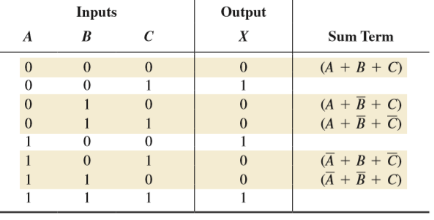
Theoretical Basis
Converting POS Expressions to Truth Table Format
Place a 0 in the output column (X) for each binary value that makes the expression a 0 and place a 1 for all the remaining binary values.
A standard POS expression:
(A + B + C)(A + B + C)(A + B + C)(A + B + C)(A + B + C)

Slide 16
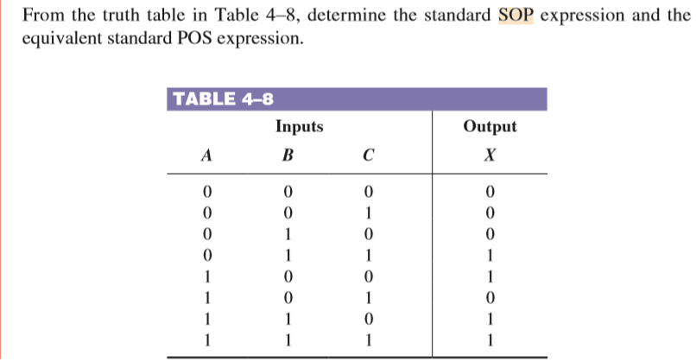
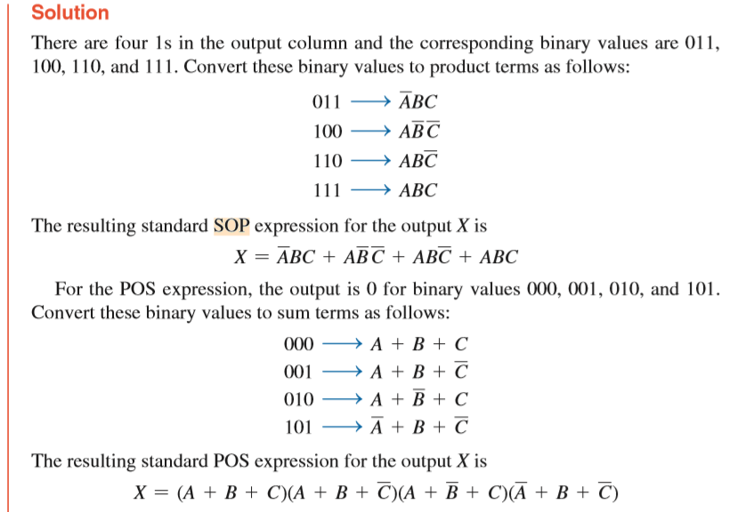
Theoretical Basis
Determining Standard Expressions from a Truth Table
Place a 0 in the output column (X) for each binary value that makes the expression a 0 and place a 1 for all the remaining binary values.

Slide 17
Theoretical Basis
Half and Full Adder
Binary adder is one of the basic combinational logic circuits. The outputs of a combinational logic circuit depend on the present input only. In other words, outputs of combinational logic circuit do not depend upon any previously applied inputs. It does not require any memory like component. Binary adder is one of the basic combinational logic circuits as present state of input variables.

Slide 18
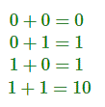
Theoretical Basis
Half and Full Adder
Half Adder
The most basic binary addition is addition of two single bit binary numbers that is addition of two binary digits. The binary digits are 0 and 1. Hence, there must be four possible combinations of binary addition of two binary bits
In the above list, first three binary operations result in one bit but fourth one result in two bits. In one bit binary addition, if augend and addend are 1, the sum will have two digits. The higher significant bit (HSB) or Left side bit is called carry and the list significant bit (LSB) or right side bit of the result is called sum bit. The logical circuit performs this one bit binary addition is called half adder.

Slide 19
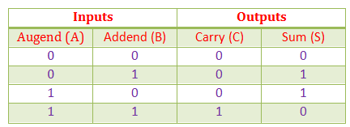
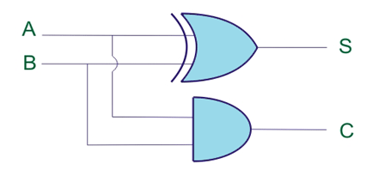
Theoretical Basis
Half and Full Adder
Half Adder
Truth Table for Half Adder: The truth table has two input variables i.e. the augend and addend bits, two outputs variables carry and sum bits.

Slide 20
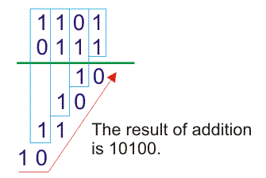
Theoretical Basis
Half and Full Adder
Full Adder
Full adder is a conditional circuit which performs full binary addition that means it adds two bits and a carry and outputs a sum bit and a carry bit.

Slide 21
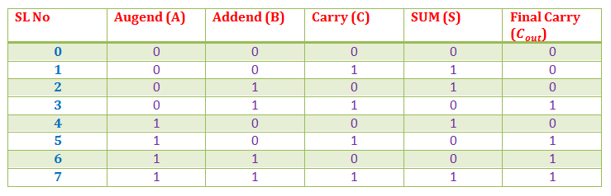
Theoretical Basis
Half and Full Adder
Full Adder
Truth table: Any bit of augend can either be 1 or 0 and we can represent with variable A, similarly any bit of addend we represent with variable B. The carry after addition of same significant bit of augend and addend can represent by C. Hence truth table for all combinations of A, B and C is as follows,

Slide 22
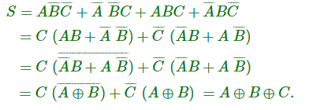
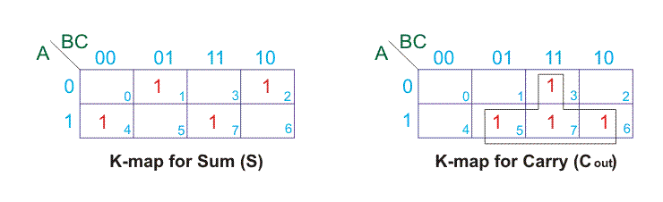
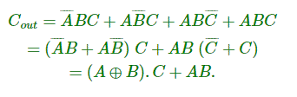
Theoretical Basis
Half and Full Adder
Full Adder

Slide 23
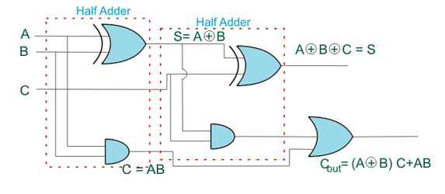
Theoretical Basis
Half and Full Adder
Full Adder

Slide 24
Experiments
Experimental purposes
Analysis of Combinatorial Logic Circuits.
Verify the logic function of half adder and full adder.
Learn the operation rules of binary Numbers.

Slide 25
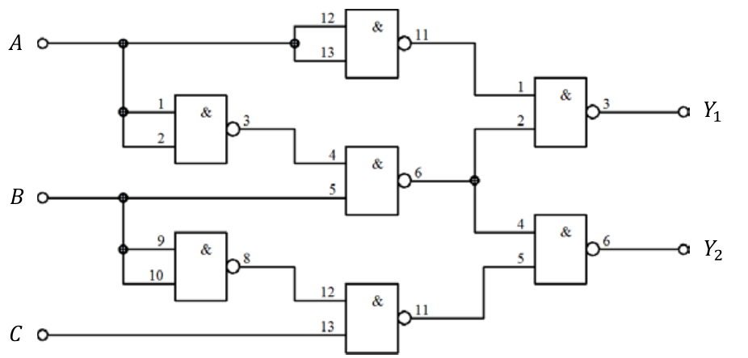
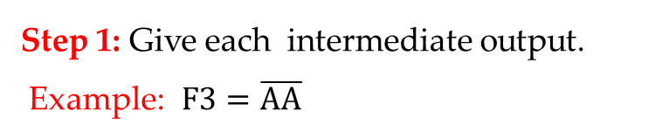
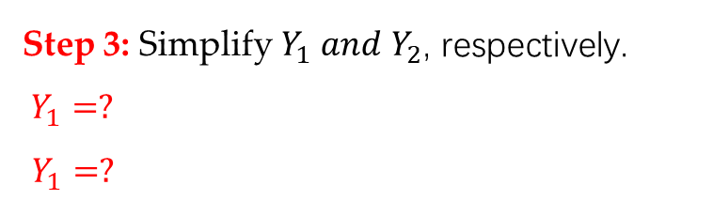
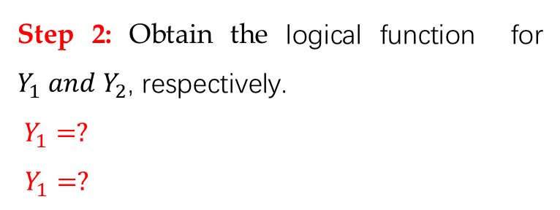
Experimental Contents
1. Combinational logic circuit function test
Task 1: Get the logical function of the digital circuit.
Step 1: Give each intermediate output.
Example: $F3=\overline{AA}$
Step 2: Obtain the logical function for $Y_{1} and$ $Y_{2}$, respectively.
$Y_{1}=?$
$Y_{1}=?$
Step 3: Simplify $Y_{1} and$ $Y_{2}$, respectively.
$Y_{1}=?$
$Y_{1}=?$

Slide 26
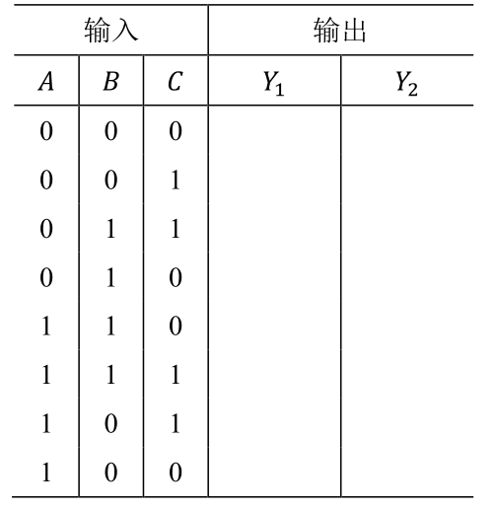
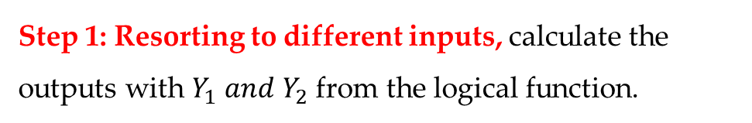
Experimental Contents
1. Combinational logic circuit function test
Task 2: Complete the truth table with Table 2.1.
Step 1: Resorting to different inputs, calculate the outputs with $Y_{1} and$ $Y_{2}$ from the logical function.

Slide 27
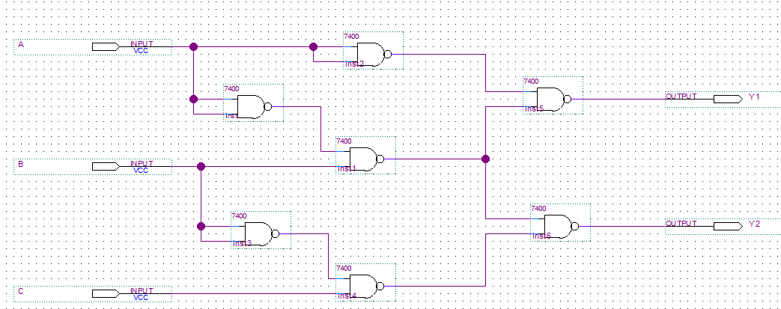
Experimental Contents
1. Combinational logic circuit function test
Task 3: Perform the virtual simulation.
Step 1: Design the combinational logic circuit in Quartus 13.1. (Use 7 seven 7400 chips

Slide 28
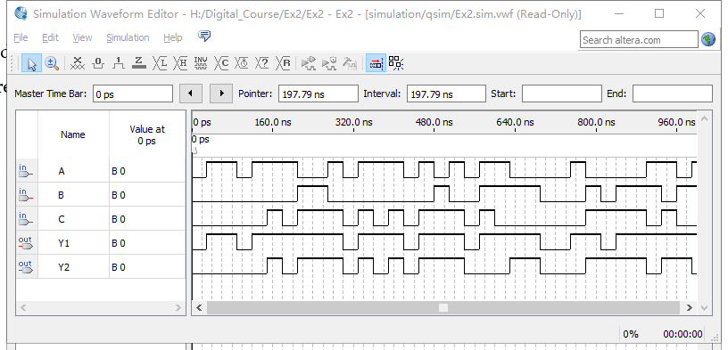
Experimental Contents
1. Combinational logic circuit function test
Task 3: Perform the virtual simulation.
Step 2: Compile the designed file, and construct the VMF to watch the simulation results.
Verify the results, compared with the truth table.

Slide 29
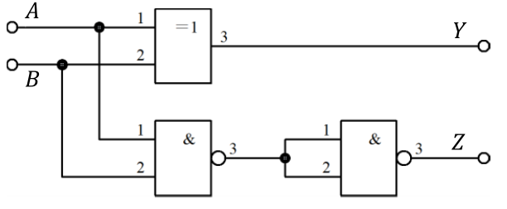
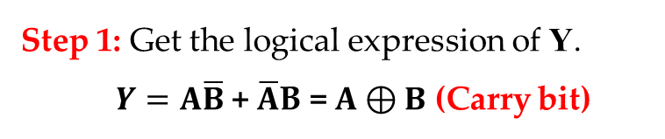
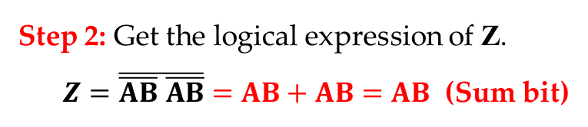
Experimental Contents
2. Test the logic function of the half adder
Review: Get the logical function of the half adder.
Step 1: Get the logical expression of Y.
$Y=A\overline{B}$ + $\overline{A}$B = $A⊕B$ (Carry bit)
Step 2: Get the logical expression of Z.
$Z=\overline{\overline{AB} \overline{AB}}=AB+AB=AB$ (Sum bit)

Slide 30
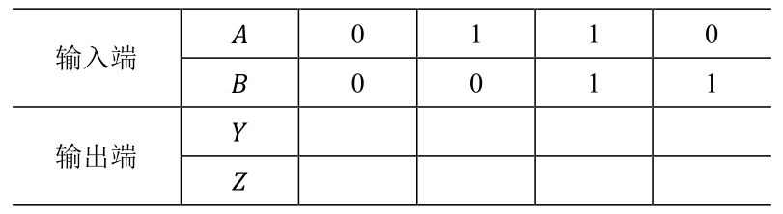


Experimental Contents
2. Test the logic function of the half adder
Task 1: Complete the truth table for half adder in Table 2.2.
Step 1: Resorting to different inputs, calculate the outputs with $Y and$ $Z$ from the logical function.
$Y=A⊕B$
$$Z=\overline{\overline{AB} \overline{AB}}=AB+AB=AB$$

Slide 31
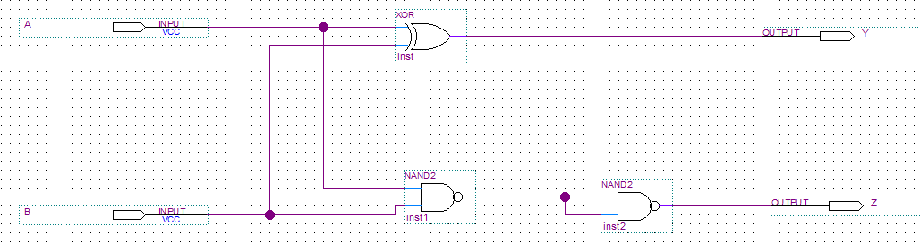
Experimental Contents
2. Test the logic function of the half adder
Task 2: Perform the virtual simulation.
Step 1: Design the logic circuit of the half adder in Quartus 13.1.

Slide 32
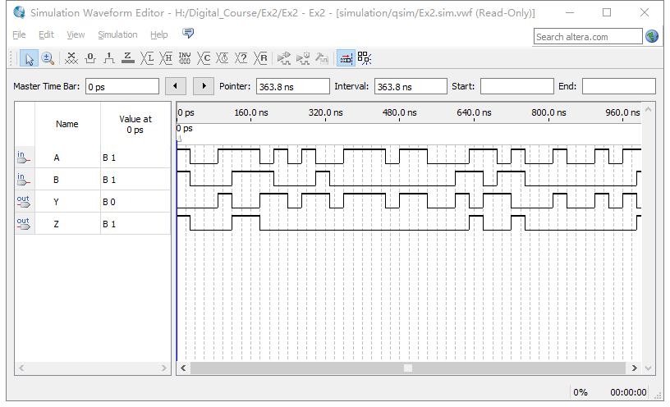
Experimental Contents
2. Test the logic function of the half adder
Task 2: Perform the virtual simulation.
Step 2: Compile the designed file, and construct the VMF to watch the simulation results.
Verify the results, compared with the truth table.

Slide 33
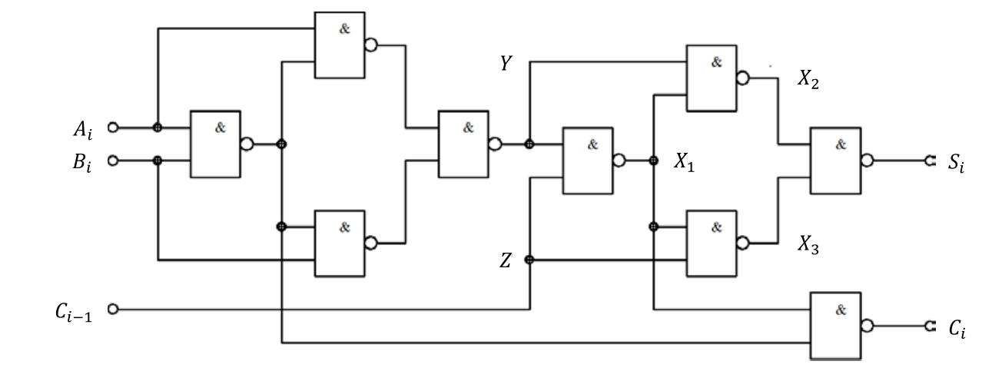
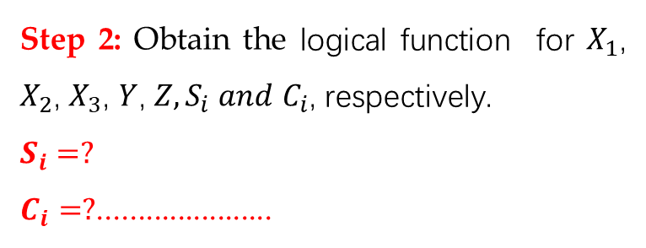
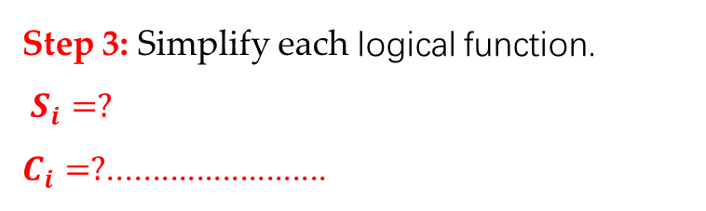
Experimental Contents
3. Test the logic function of the full adder in not simplified circuit
Task 1: Get the logical function of the digital circuit.
Step 1: Give each intermediate output.
Step 2: Obtain the logical function for $X_{1}$, $X_{2}$, $X_{3}$, $Y$, $Z,S_{i} and$ $C_{i}$, respectively.
$$S_{i}=?$$
$C_{i}=?$......................
Step 3: Simplify each logical function.
$S_{i}=?$
$C_{i}=?$.........................

Slide 34
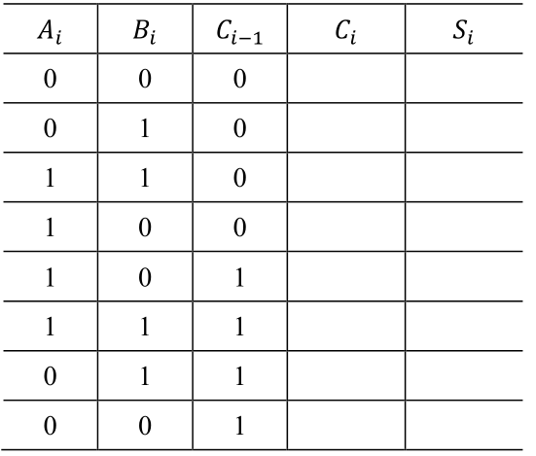
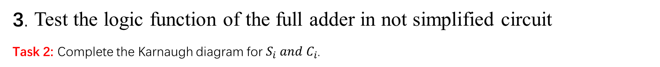
Experimental Contents
3. Test the logic function of the full adder in not simplified circuit
Task 2: Complete the Karnaugh diagram for $S_{i} and$ $C_{i}$.
Step 1: Resorting to different inputs, calculate the outputs with $Y_{1} and$ $Y_{2}$ from the logical function.

Slide 35
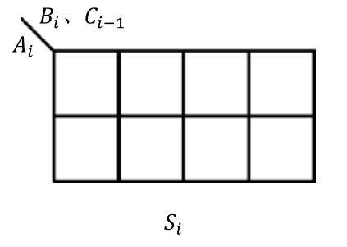
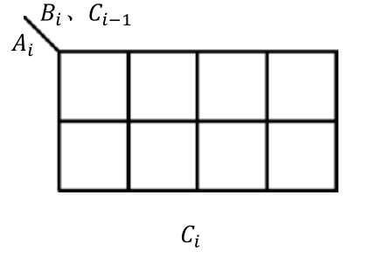

Experimental Contents
3. Test the logic function of the full adder in not simplified circuit
Task 3: Complete the Karnaugh diagram for $S_{i} and$ $C_{i}$.

Slide 36
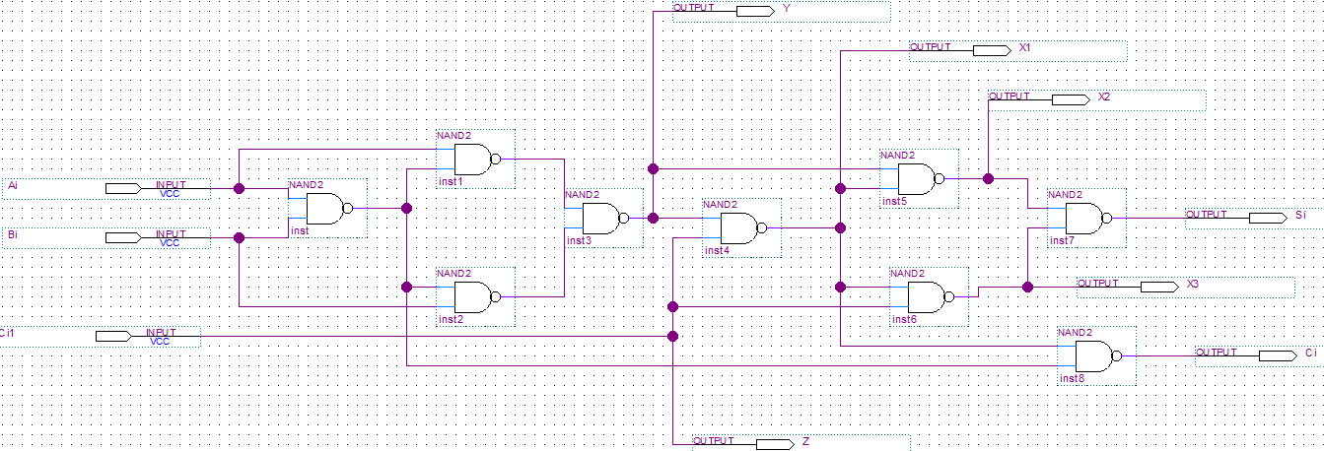
Experimental Contents
3. Test the logic function of the full adder in not simplified circuit
Task 4: Perform the virtual simulation.
Step 1: Design the logic circuit of the half adder in Quartus 13.1.

Slide 37
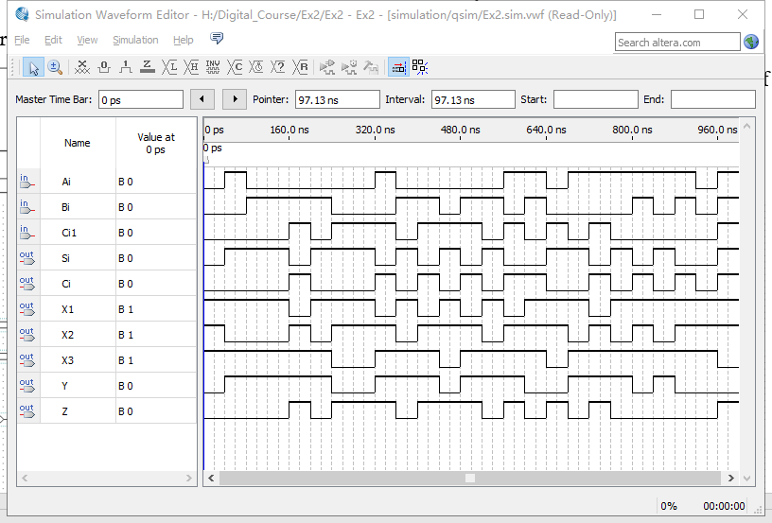
Experimental Contents
3. Test the logic function of the full adder in not simplified circuit
Task 5: Perform the virtual simulation.
Step 2: Compile the designed file, and construct the VMF to watch the simulation results.
Use the results to finish the Table 2.3.
Verify the results, compared with the truth table.

Slide 38
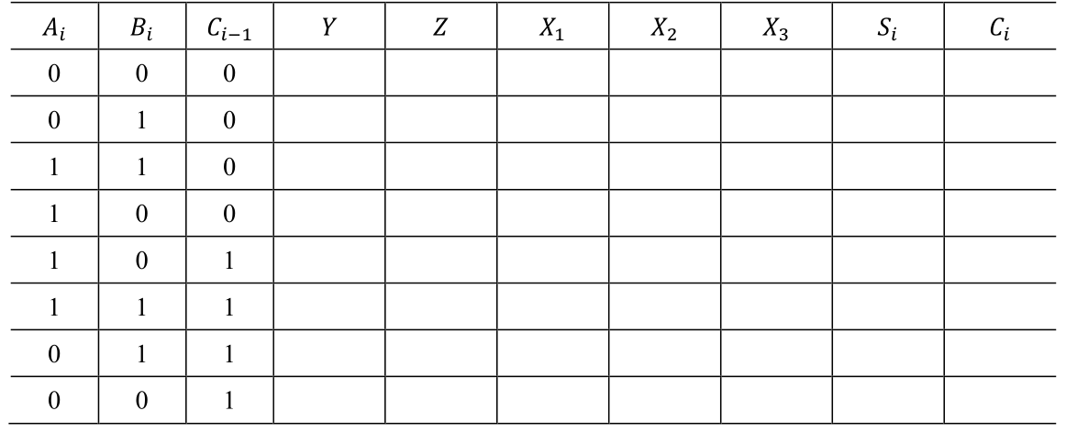
Experimental Contents
3. Test the logic function of the full adder in not simplified circuit
Task 5: Perform the virtual simulation.
Step 3: Use the results to finish the Table 2.3.
Step 4: Verify the results, compared with the truth table.

Slide 39
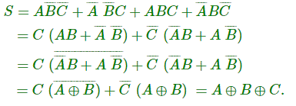
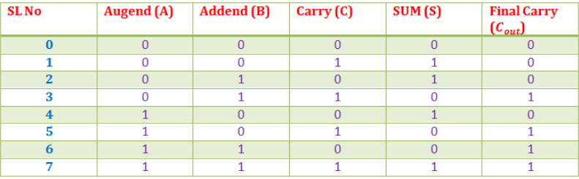

Experimental Contents
4. Design a and full adder using the simplified circuit and test its function
Task 1: Use two XOR gates, a and-or-invert gate (7454), and NAND gate to design the full adder.
Step 1: Master the principal and write the logical expression

Slide 40
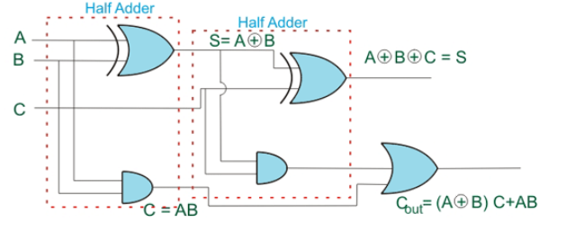
Experimental Contents
4. Design a and full adder using the simplified circuit and test its function
Task 1: Use two XOR gates, a and-or-invert gate (7454), and NAND gate to design the full adder.
Step 2: According the logical expression, design the specific circuit for the full adder.

Slide 41
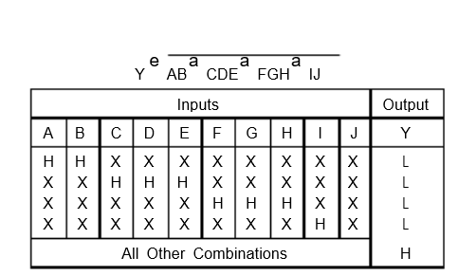


Experimental Contents
4. Test the logic function of the full adder in simplified circuit
Task 2: Perform the virtual simulation.
Step 1: Understand the theory about 7454 chip.
$$Y=\overline{AB+CDE+FGH+IJ}$$

Slide 42

Experimental Contents
4. Test the logic function of the full adder in simplified circuit
Task 2: Perform the virtual simulation.
Step 2: Design the logic circuit of the full adder in Quartus 13.1.

Slide 43


Experimental Contents
4. Test the logic function of the full adder in simplified circuit
Task 2: Perform the virtual simulation.
Step 3: Use the results to finish the Table 2.5.
Step 4: Verify the results, compared with the Table 2.4.

Slide 44
Thanks

